Slide 1

COIT11241 Wk6 A2 Defend
Jake Kenealy
12197775

Slide 2
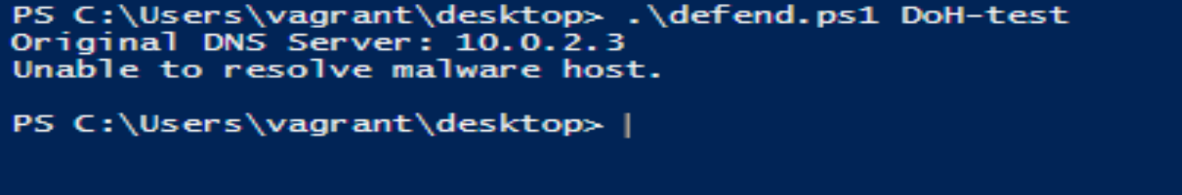
Steps #1-4
The output of testDNSBlock() after cleaning with PSScriptAnalyzer is as follows.
This portion originally didn’t run properly. I had to manually set the DNS server to 10.0.2.3 within settings in order to get any output.

Slide 3
Step #5
This is the output for enableDoH() function before the system restarts*
* Line in script that restarts was commented out for purposes of screenshot. This would happen too quickly to capture with Snip-Tool.

Slide 4
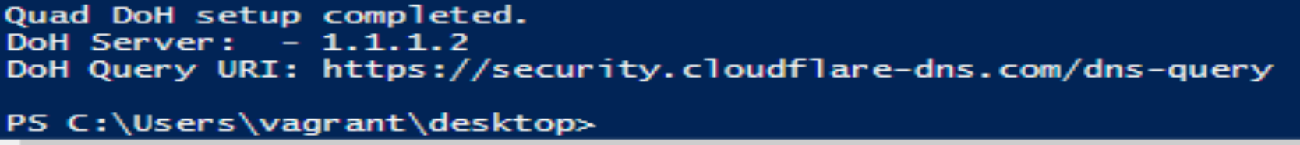
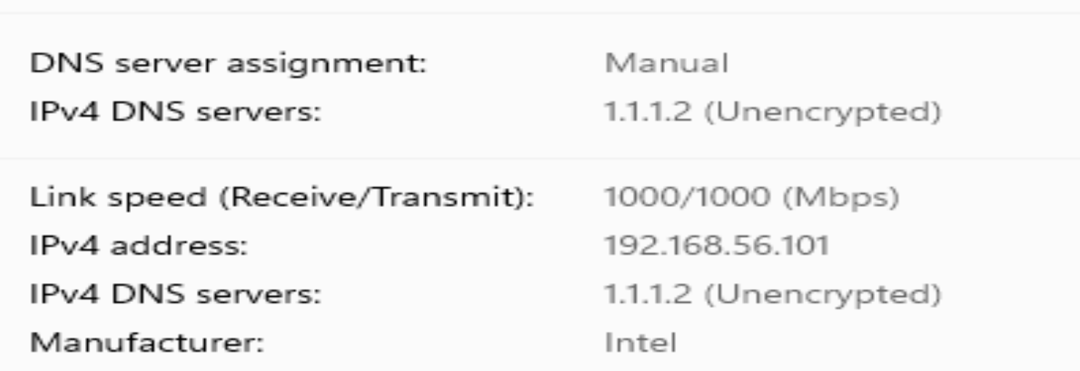
Step #6
The output for setupQuadDoH() is as follows. As can be seen from both the oputput and the DNS settings, the function has changed the DNS server from 10.0.2.3 to 1.1.1.2

Slide 5
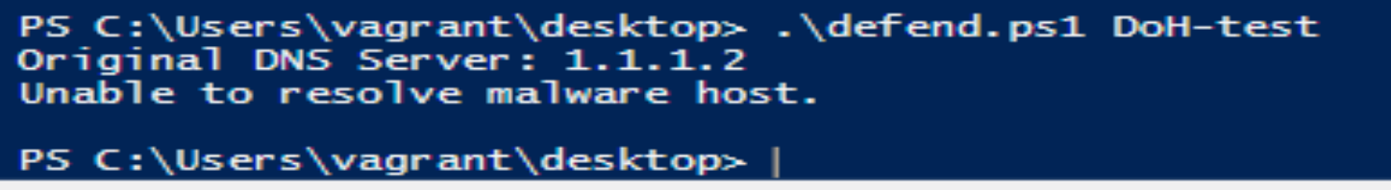
Step #7
As can be seen from the Post-Test, the DNS has been changed to 1.1.1.2

Slide 6
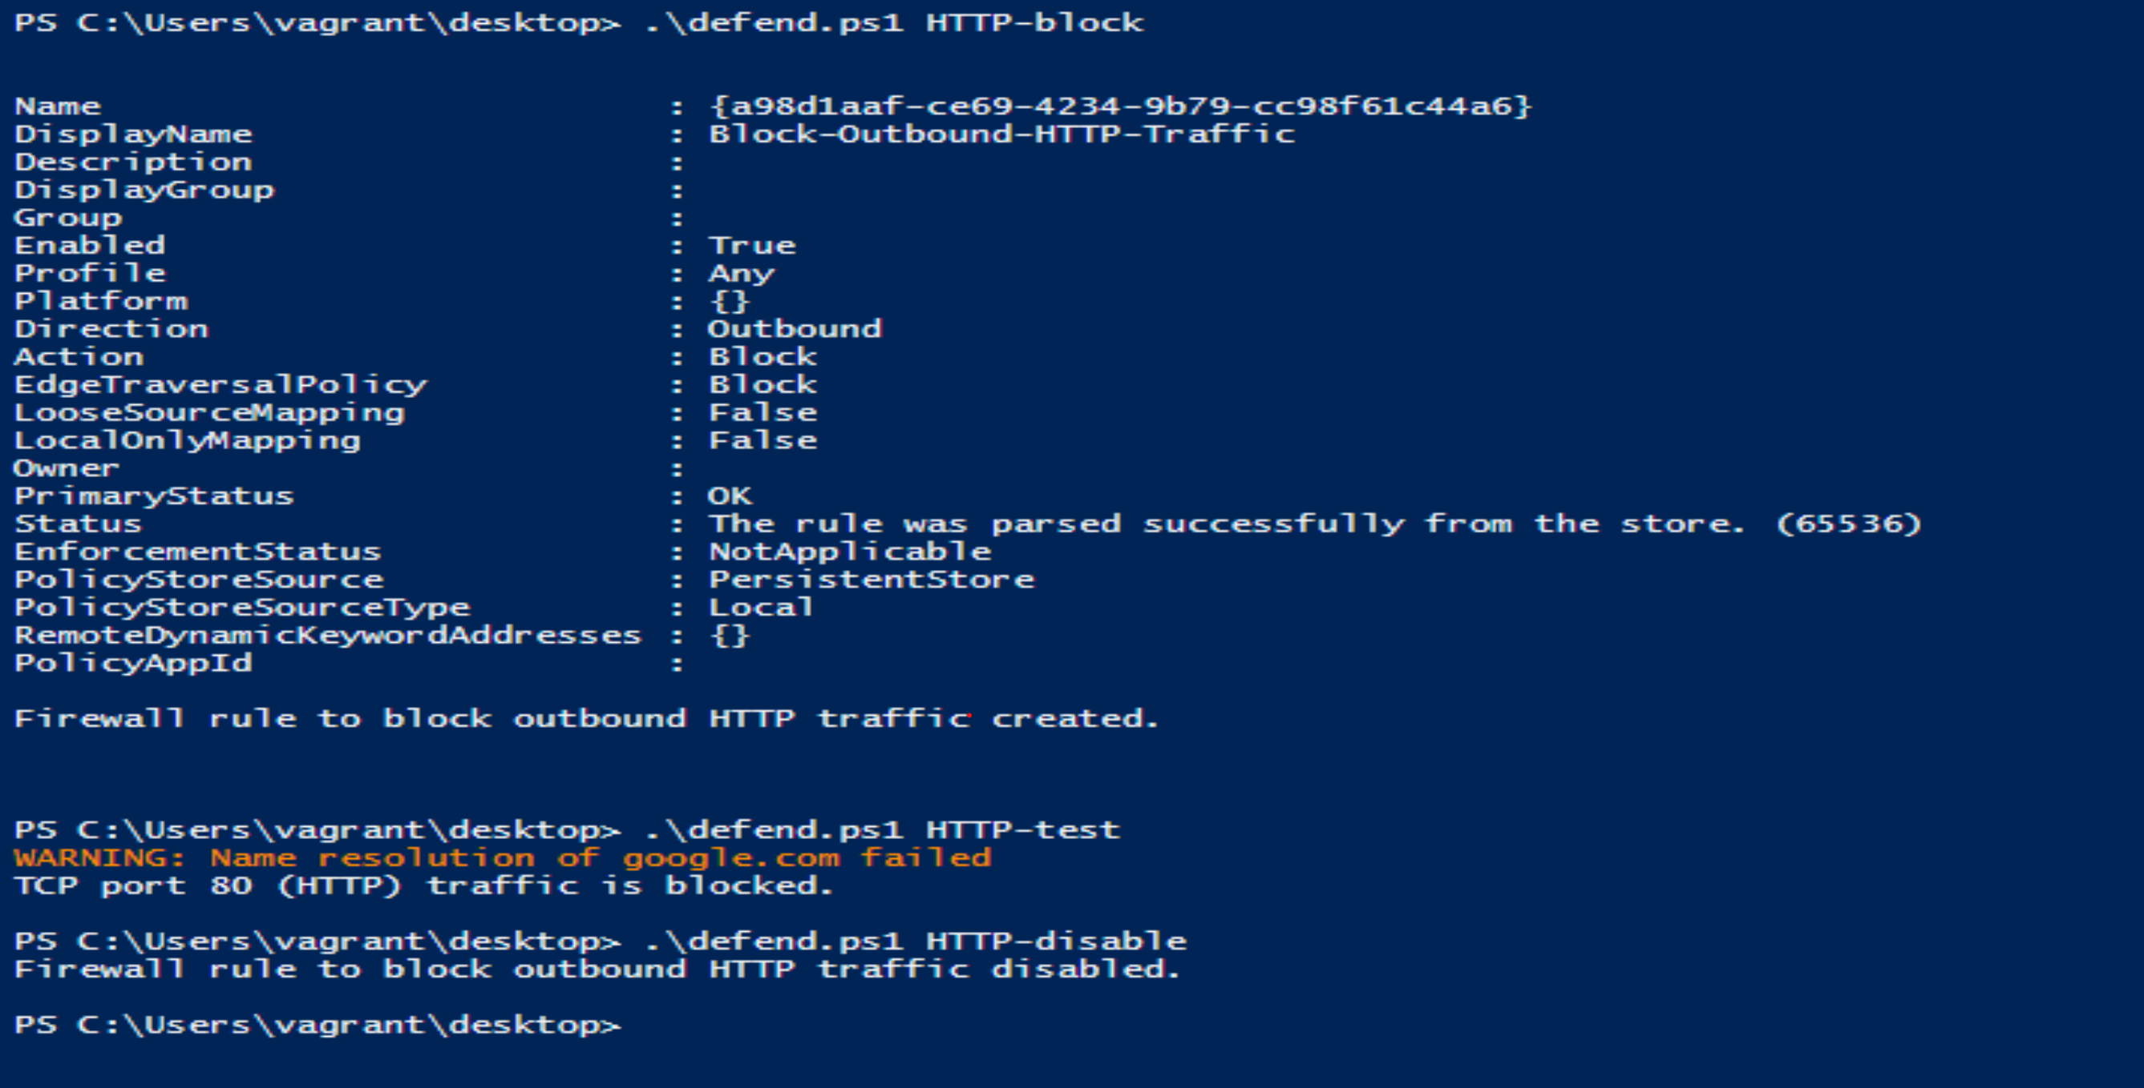
Step #9
The output for Step #9 is as follows. The script is able to block HTTP traffic using HTTP-Block. This is shown to be blocked via the use of HTTP-test. This can then be unblocked using HTTP-disable.

Slide 7
Credit
Jake Kenealy 12197775
GitHub Link: https://github.com/Jake-Kenealy/COIT11241---Wk6A2Defend.git
Chat.openai.com ChatGPT / August 27, 2023 version (Used the prompts: https://chat.openai.com/share/0b4b5c22-fbaf-4e40-912b-b3efb69697e6 )

